Slide 1
Hour 4
Understanding How Java Programs Work

Slide 2
Review
What are the two types of programming languages?
Interpreted
Compiled
When you compile a Java program, what are you doing?
Converting it into a form the computer can understand
What is a variable?
A place to store information in a program
What is the process of fixing errors called?
Debugging

Slide 3
Review
Keywords
class
public
static
void
Special characters
( )
{ }
[ ]
Types
String
API Calls
System.out.println()

Slide 4
Two Types of Java Programs
Applications
Programs that run on your computer
Applets
Programs that run on a web page

Slide 5
Creating an Application
HelloWorld was our first application
New application: Root
Will compute the square root of a number
File > New File…
Category: Java
Type: Empty Java File
Next
Class Name: Root

Slide 6
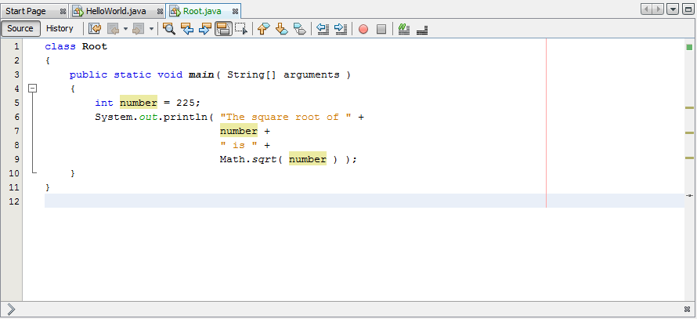
Creating an Application
Initialized to 225
Type int (integer) = whole numbers
Variable number

Slide 7
Creating an Application
Normal print command
Concatenation
Prints contents of number
Compute square root of number AND print it

Slide 8
Setting up Java Path
Set up Java so that it can be run from the command line
Add java to your path
Open Windows Explorer
Go to
C:\Program Files\Java\jdk1.7.0_21\bin, or
C:\Program Files(x86)Java\jdk1.7.0_21\bin
Right-Click on “Computer” -> Select Properties
Click Advanced System Settings
Click Environment Variables
Under User Variables, Click New…
Variable Name: PATH
Variable Value: C:\Program Files\Java\jdk1.7.0_21\bin;%PATH%

Slide 9
Run Java From the Command Line
Open command tool:
Windows 7: Start > Run… > Type “cmd”
Windows 8: Start Screen > All Apps > Windows System > Command Prompt
Type:
cd c:\Users\XXX\Documents\NetBeansProjects\Examples\build\classes
java HelloWorld
This is what Netbeans is doing when we hit run
We can add arguments
java TextDisplayer readme.txt /p “Page Title”

Slide 10
Sending Arguments to Applications
New application: BlankFiller
Will use command line arguments to fill in the blanks in a sentence
File > New File…
Category: Java
Type: Empty Java File
Next
Class Name: BlankFiller

Slide 11
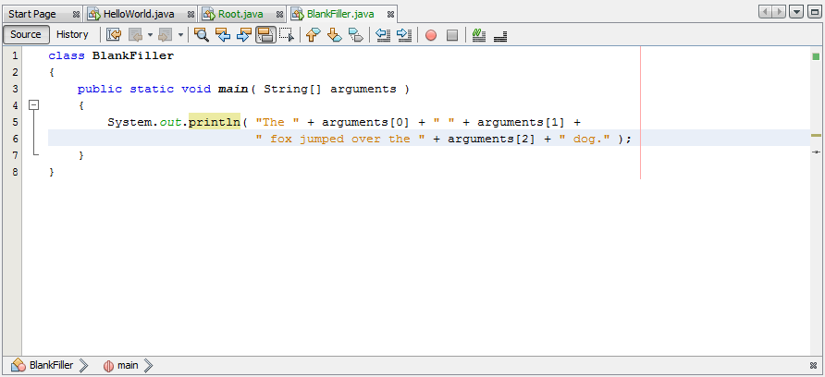
Sending Arguments to Applications
Array: 0 to N of the same type of thing
Arrays always start from 0 – i.e. 0 is the first item in array
Next arg
Next arg

Slide 12
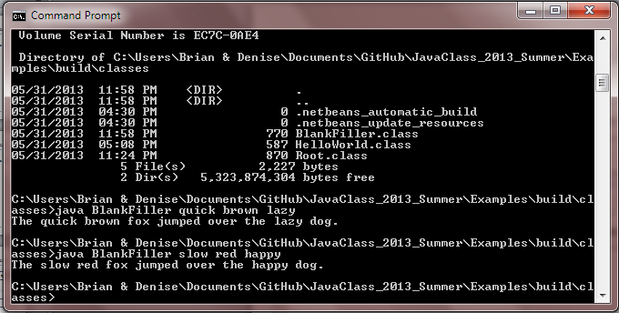
Sending Arguments to Applications
Run BlankFiller from command line
cd to path, java BlankFiller crazy red happy
Run from Netbeans
Run > Set Project Configuration > Customize…
Main Class: BlankFiller, Arguments: quick brown lazy (choose 3 adjectives) OK
Run

Slide 13
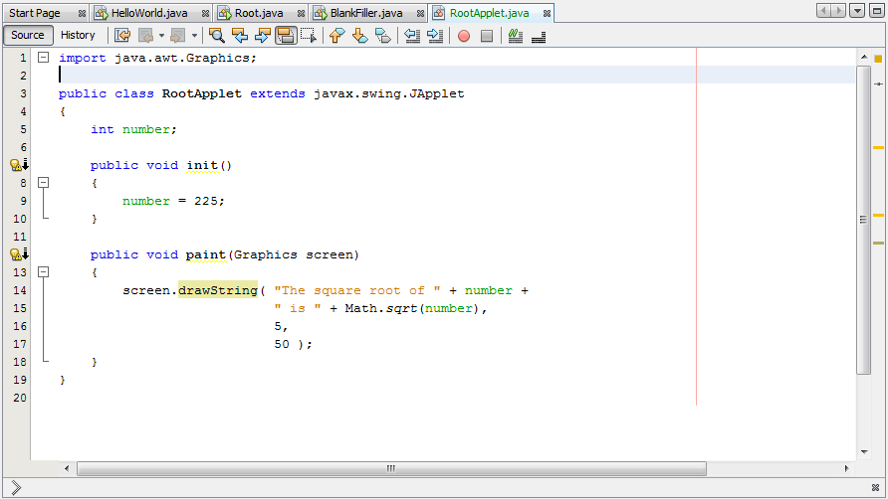
Creating an Applet
extends – inheritance – gets properties of JApplet
Member of class Root Applet
init() – inherited from JApplet – JApplet always calls this on startup
paint() – inherited from JApplet – JApplet calls this every time the screen is painted

Slide 14
Creating an Applet
Graphics screen – tells paint where to draw
drawString – draws a sting on the screen
X position
Y position

Slide 15
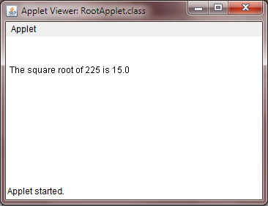
Creating an Applet
0
5
X Position
0
Y Position
50

Slide 16

Hint: Changing a String to an int
You can’t to math on a String
You need to change the String to an int
Integer.decode() will do the trick

Slide 17
GitHub
Go to http://github.com
Create an account (free)
Create a user name
Enter your email (ask if you can use your parents)
Create a password you can remember
Click “Sign up for free”
Setup GitHub
Click on “Set Up Git”
Click on “Download Github for Windows”
In the download popup, click “Run”
In the security warning popup, click “Install” and wait for the download to complete
GitHub tool launches automatically
Run the GitHub windows tool
Sign in using your new username and password
On the configure page, enter your first and last name and email address
In Internet Explorer, go to https://github.com/bcraig108/JavaClass_2013_Summer
Click Fork
Click Clone in Windows
You can view these slides, and examples
You can upload your homework
I will post homework solutions

Slide 18
Summary
Created Java Application that computes square roots
Created Java Application that uses arguments
Created Java Applet

Slide 19
Questions

Slide 20
Homework
Create a New Project: “Homework_yourname” in C:\Users\<UserName>\Documents\GitHub\JavaClass_2013_Summer
In the Homework_yourname project, using the Root application as a guide, create a NewRoot application that can display the square root of 625
In the Homework_yourname project, using the Root application as a guide, create an ArgRoot application that can display the square root of the number provided as an argument
Upload the new project to GitHub (sync)

